Slide 1
Grants Portal
General Areas
& Quick Tips

Slide 2
Layers of the Database Onion
Preliminary Damage Assessments (PDAs) are completed and entered into NEMIS
Presidential declaration for Event achieved
3) Recipient electronically requests federal funding by submitting the SF-424 through EMMIE External
4) FEMA approves the SF-424 in EMMIE Internal
5) Information is then loaded into Grants Portal & Grants Manager

Slide 3
Obtaining Access to Grants Portal
FEMA grants access to Recipient
Recipient grants access to Applicant
Applicant manages their personnel

Slide 4
Recipient will collect Applicant’s Email addresses at the Applicant Briefings

Slide 5
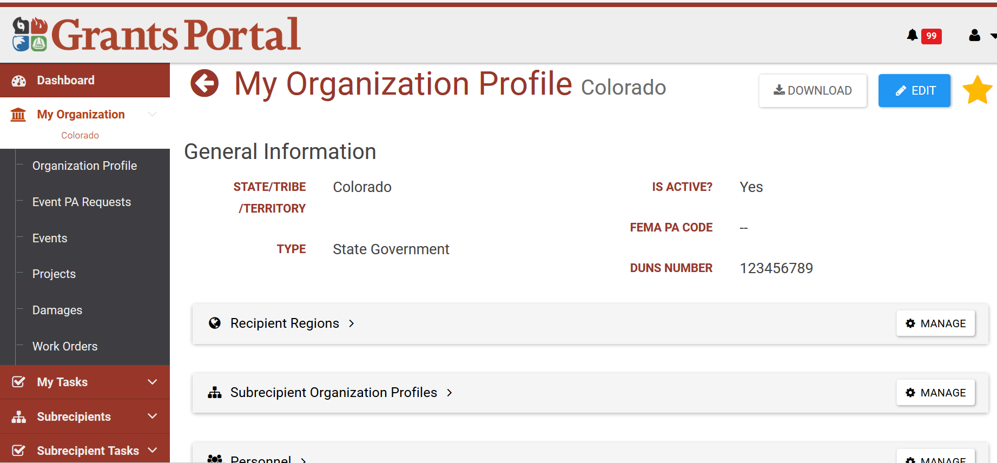
Recipient utilizes their rights granted by FEMA to invite Applicants to use Portal

Slide 6
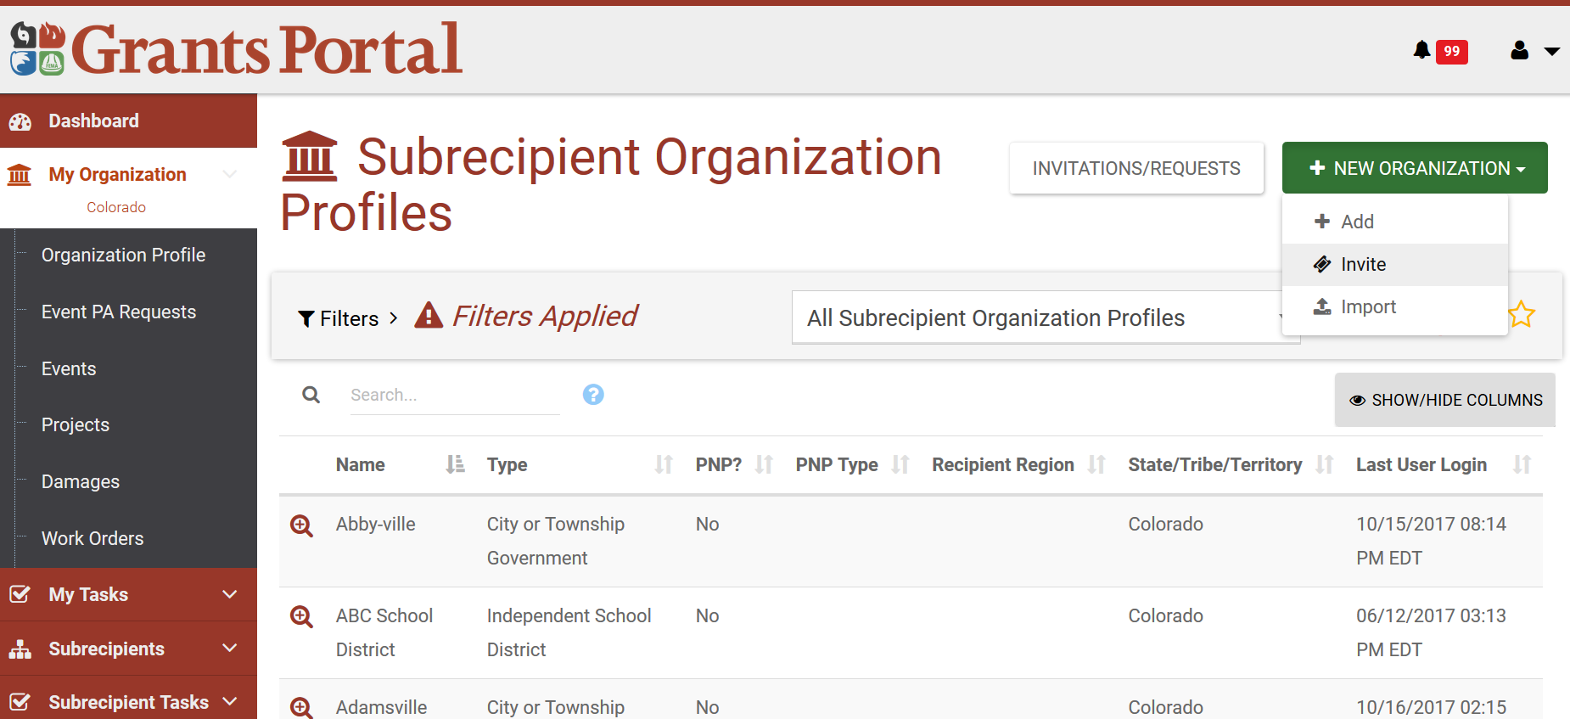
Recipient utilizes their rights granted by FEMA to invite Applicants to use Portal

Slide 7
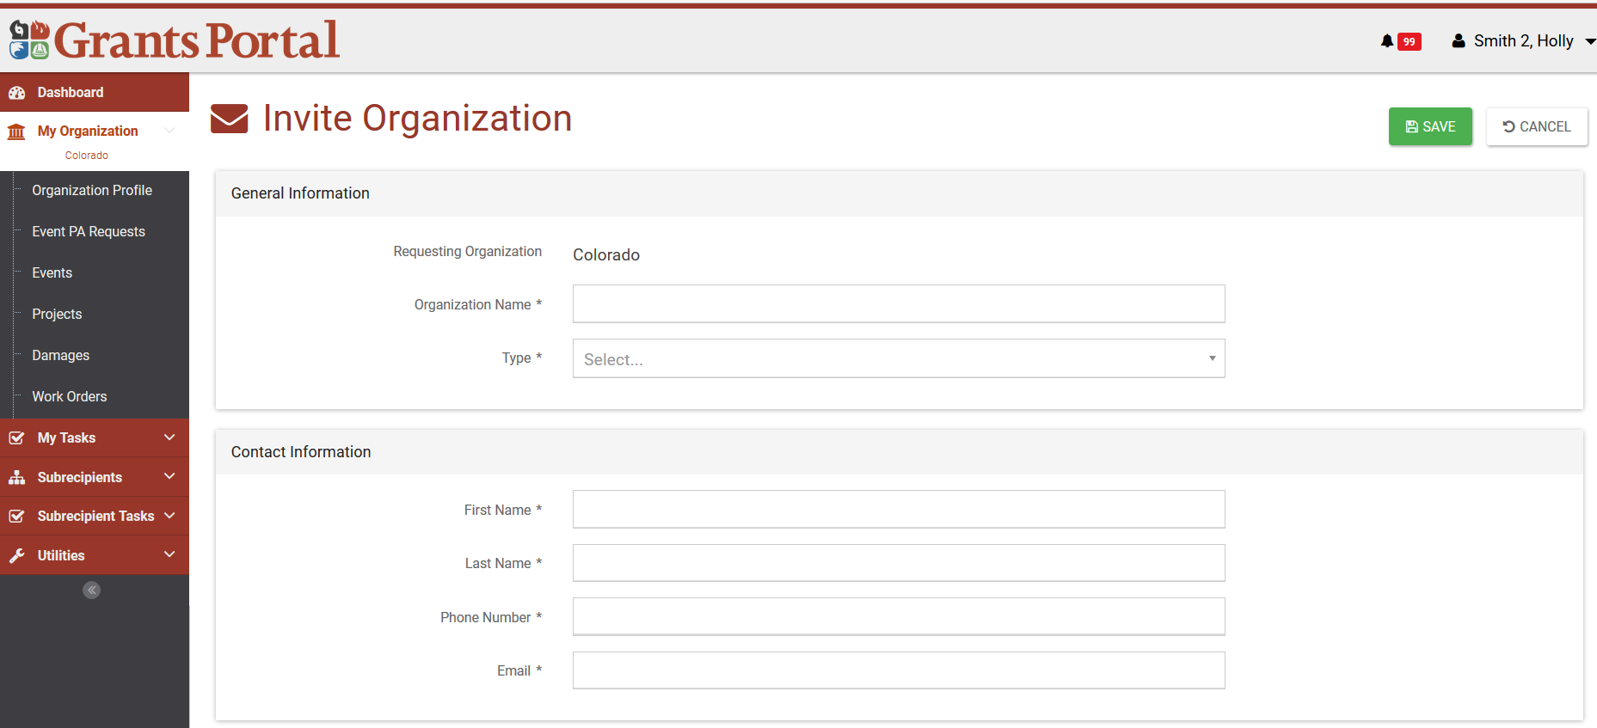
Recipient utilizes their rights granted by FEMA to invite Applicants to use Portal

Slide 8
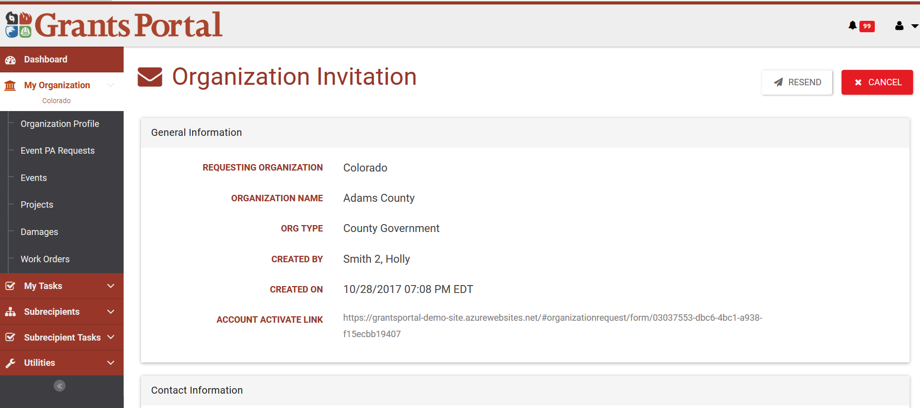
Recipient utilizes their rights granted by FEMA to invite Applicants to use Portal

Slide 9
Applicant awaits Invite Email from the Grants Portal
Applicant should be regularly checking the Email address provided to the Recipient at the Applicant Briefing.
Ensure that their IT systems allow for incoming emails from support@pagrants.fema.dhs.gov
Remind Applicant to occasionally check their spam folder just in case…

Slide 10
Upon receiving Invite Email, Applicant clicks the link to create their organization
Applicant clicks the link “here” to go right into the system.

Slide 11
Applicant will need to first enter their organization information

Slide 12
Applicant will need to enter their contact information

Slide 13
Applicant will need to enter their location information

Slide 14
Applicant will need to add the applicable counties

Slide 15
Applicant will need to review all their entered information (scrolling down)

Slide 16
Applicant will click “Submit” button

Slide 17
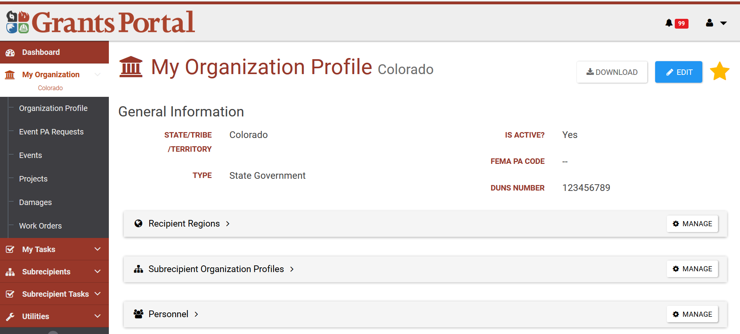
“Edit” Organization Options

Slide 18
Manage Regions

Slide 19
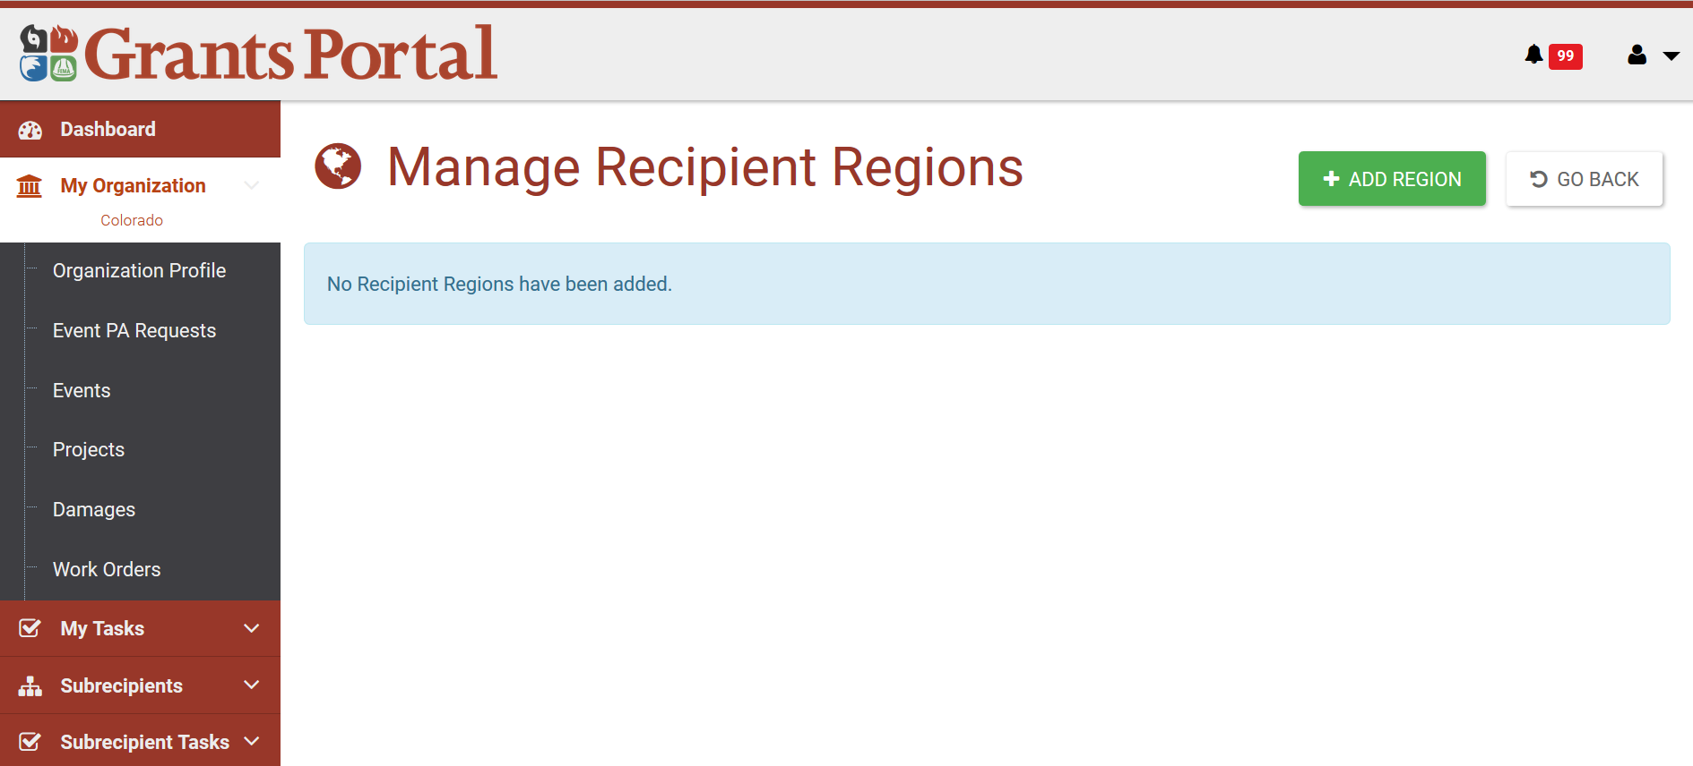
Manage Regions
Notes:
Address the Edit, lock/unlock account, and managing system roles.

Slide 20
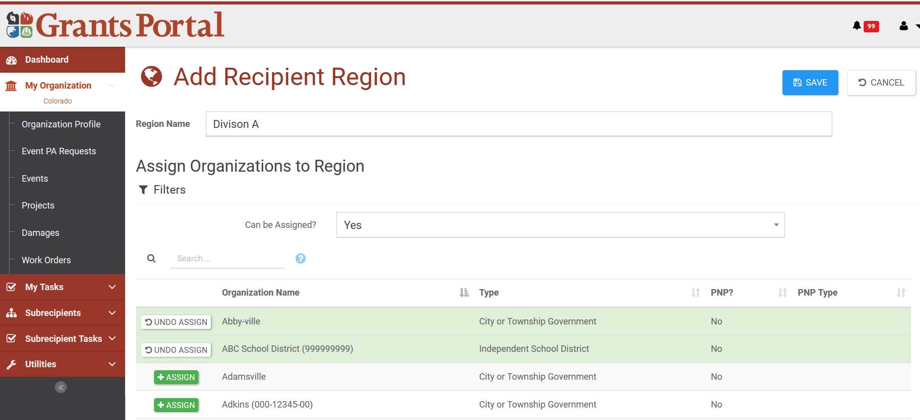
Manage Regions
Notes:
Address the Edit, lock/unlock account, and managing system roles.

Slide 21
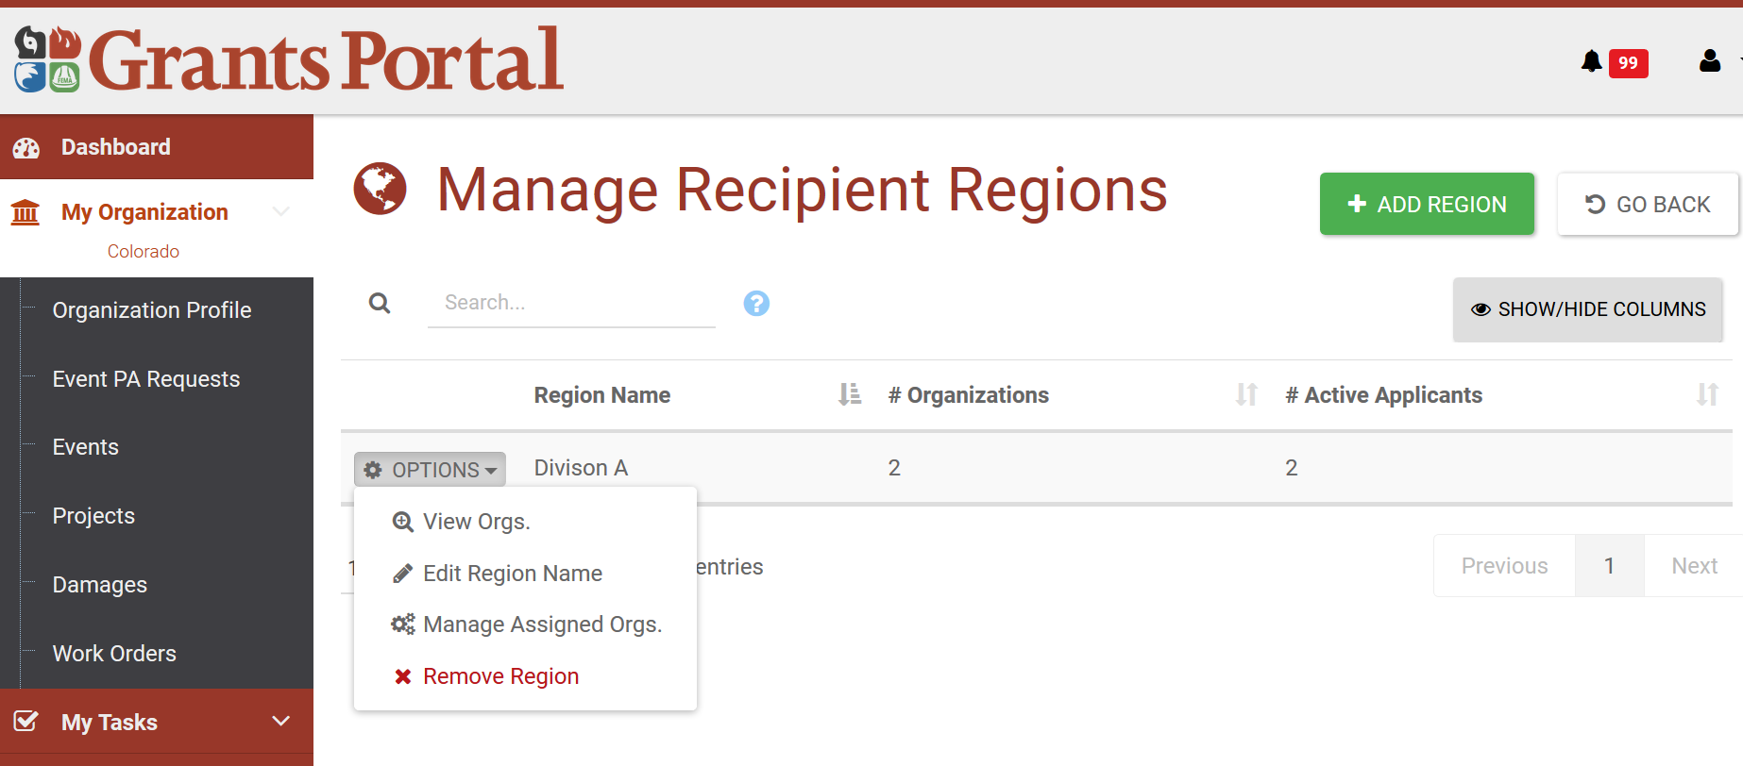
Manage Regions
Notes:
Address the Edit, lock/unlock account, and managing system roles.

Slide 22
Manage Subrecipient Organization Profiles

Slide 23
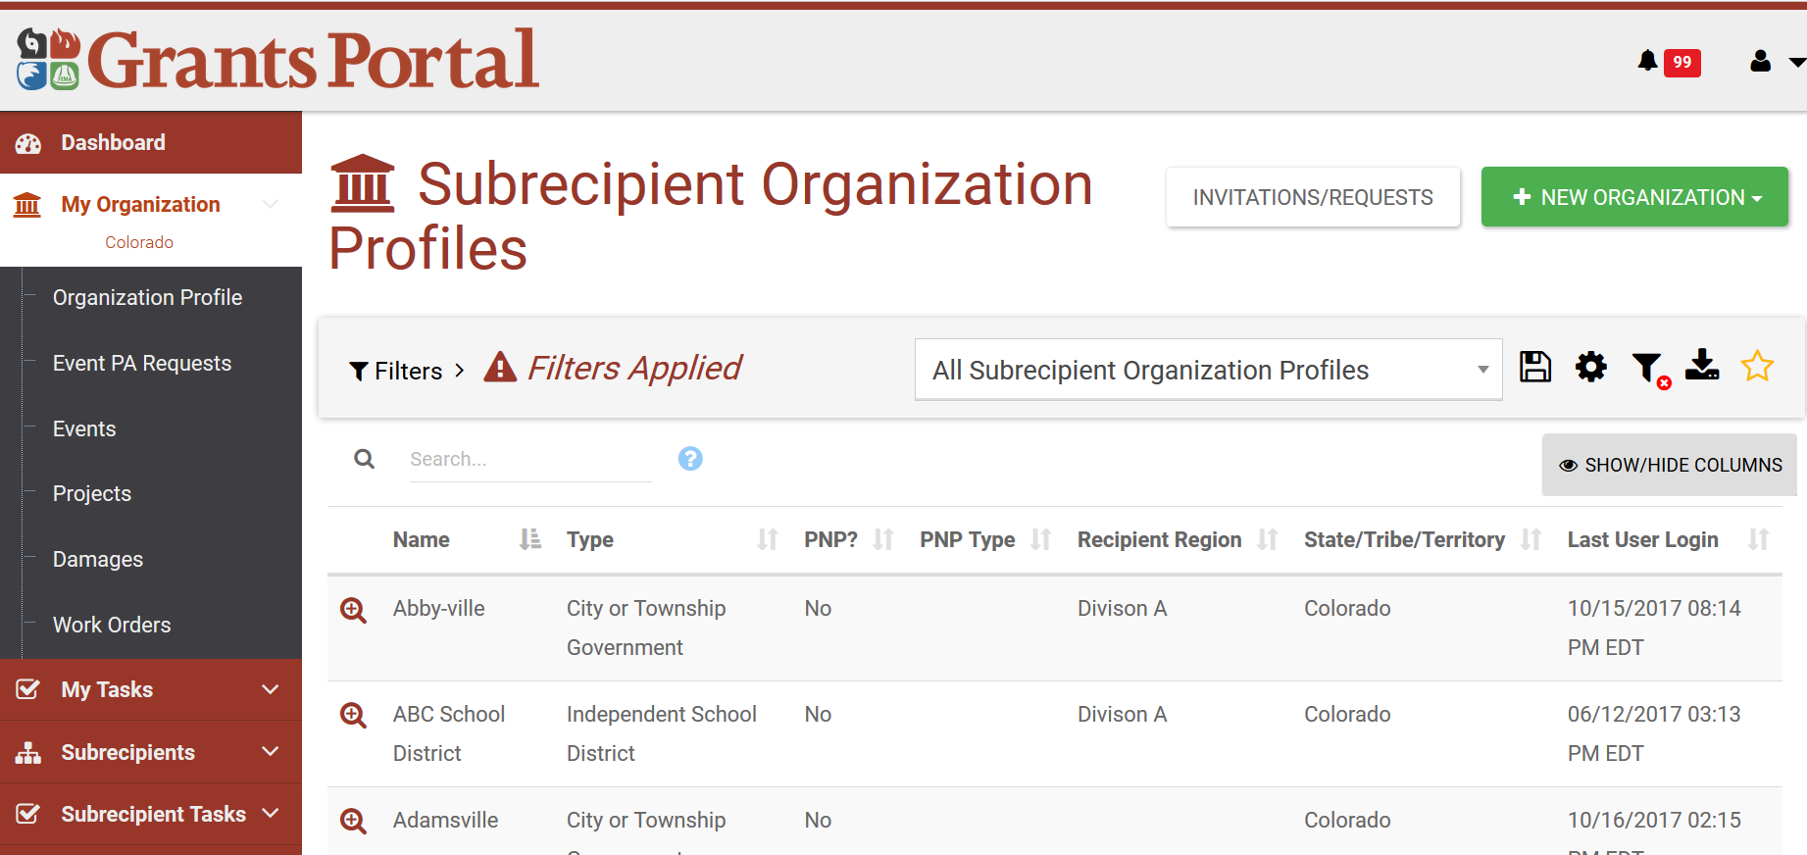
Manage Subrecipient Organization Profiles

Slide 24
Manage Personnel

Slide 25
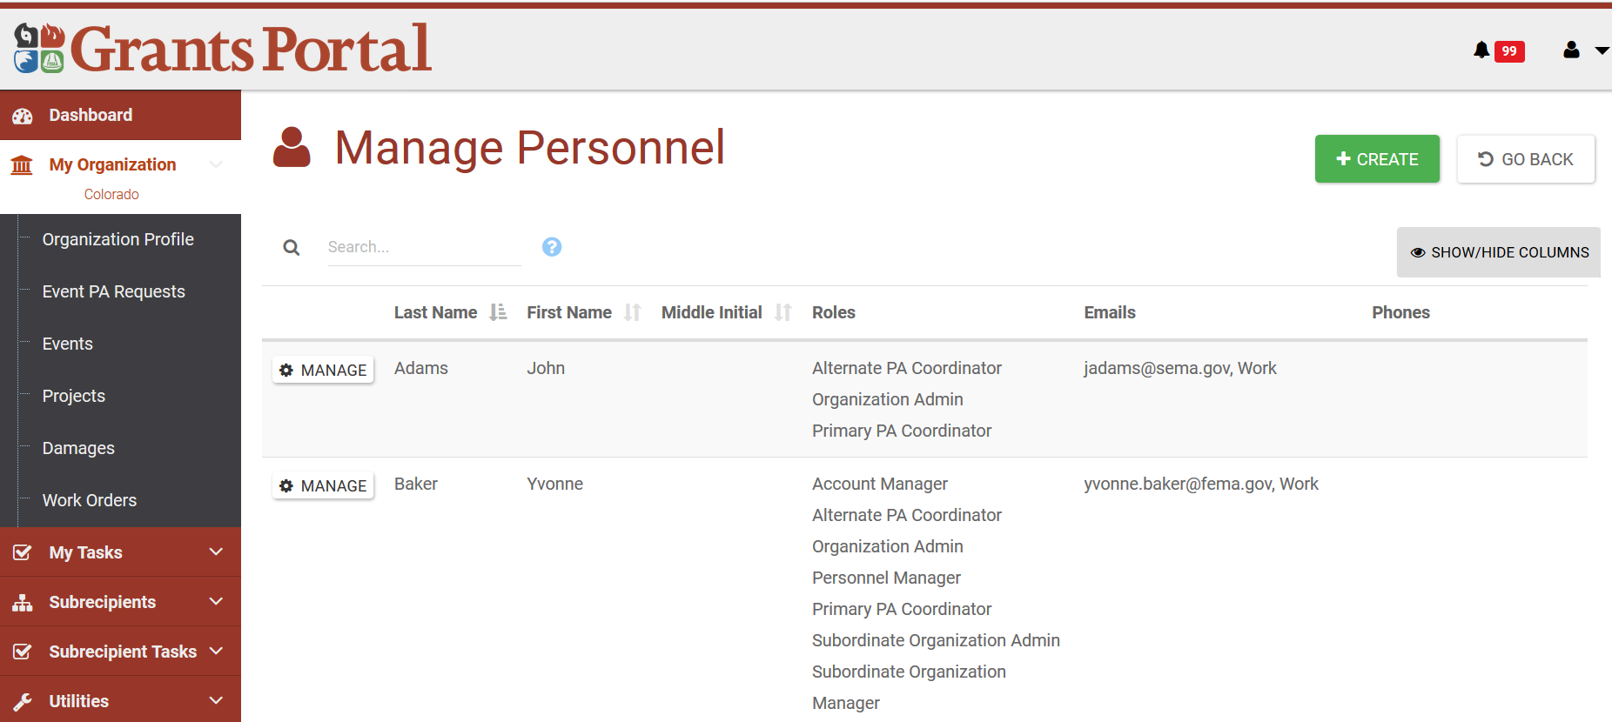
Manage Personnel

Slide 26
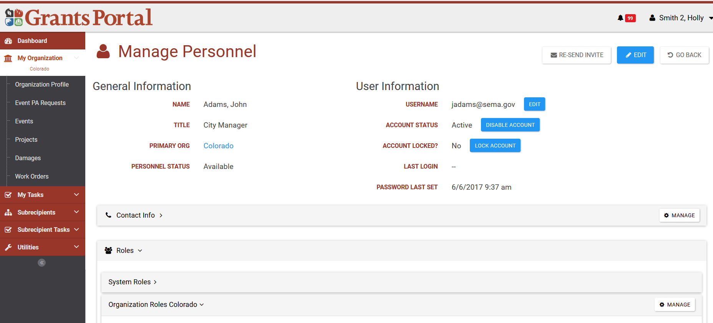
Manage Personnel
Notes:
Address the Edit, lock/unlock account, and managing system roles.

Slide 27
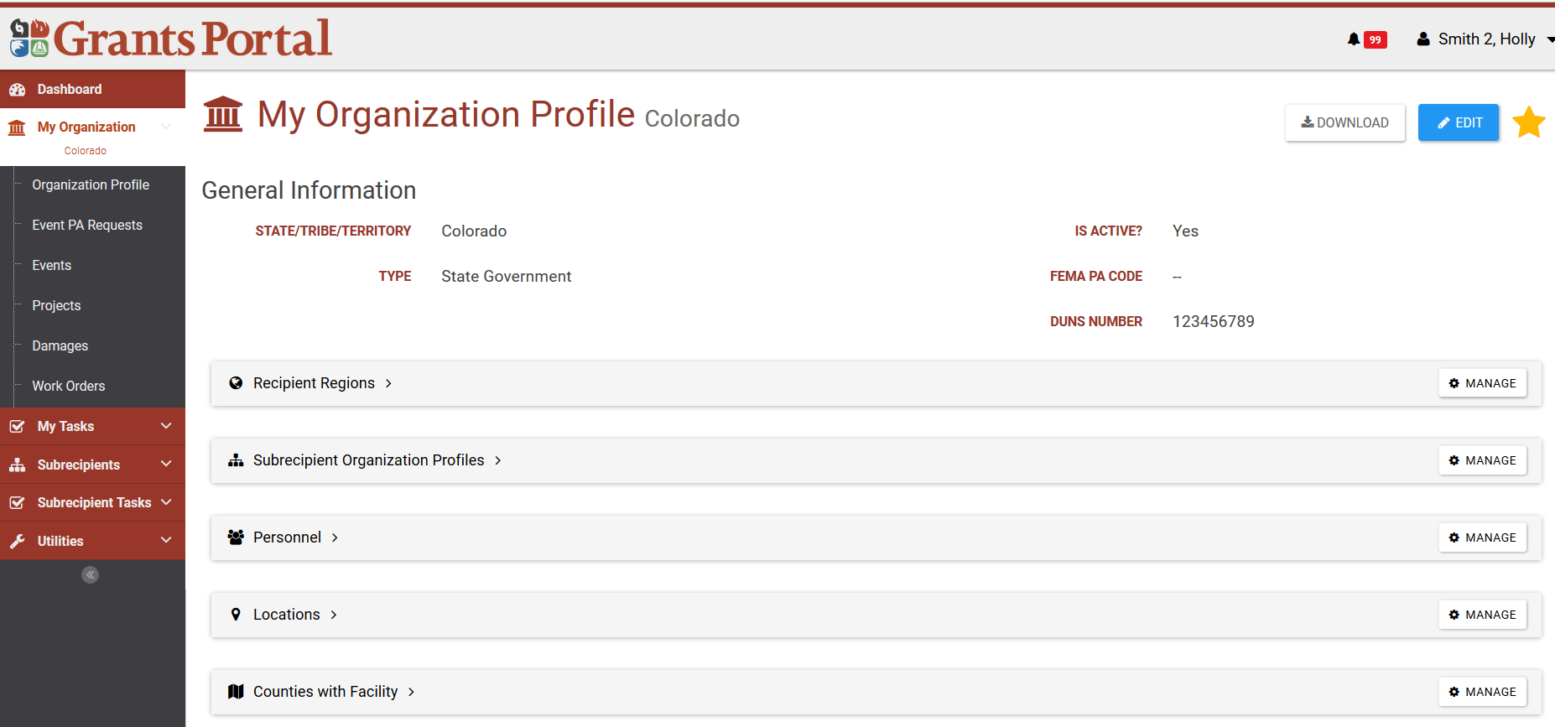
Manage Locations

Slide 28
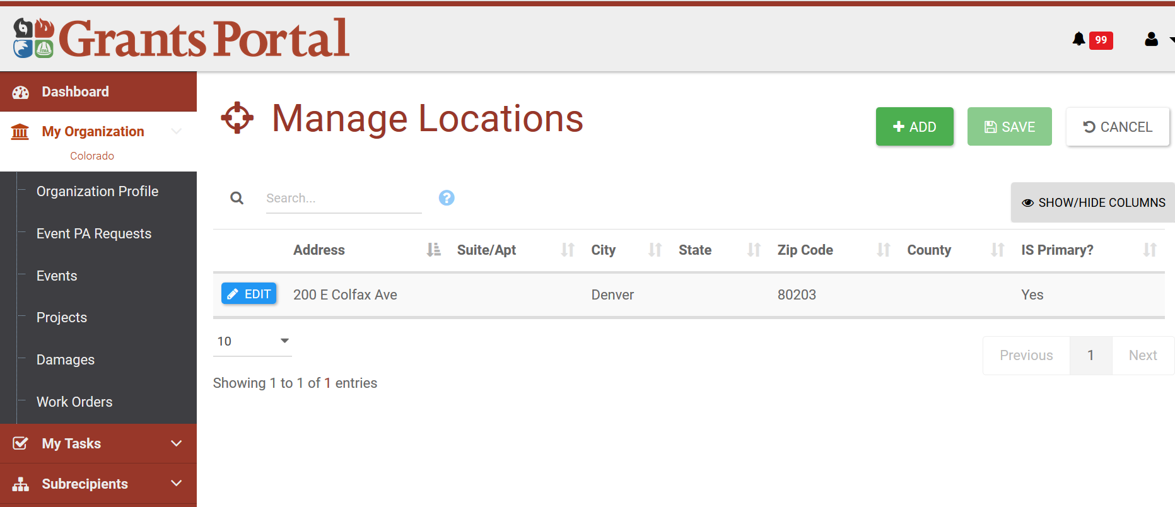
Manage Locations

Slide 29
Manage Counties with Facility

Slide 30
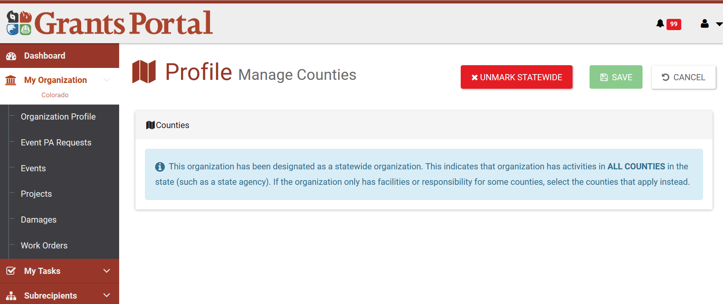
Manage Counties with Facility

Slide 31
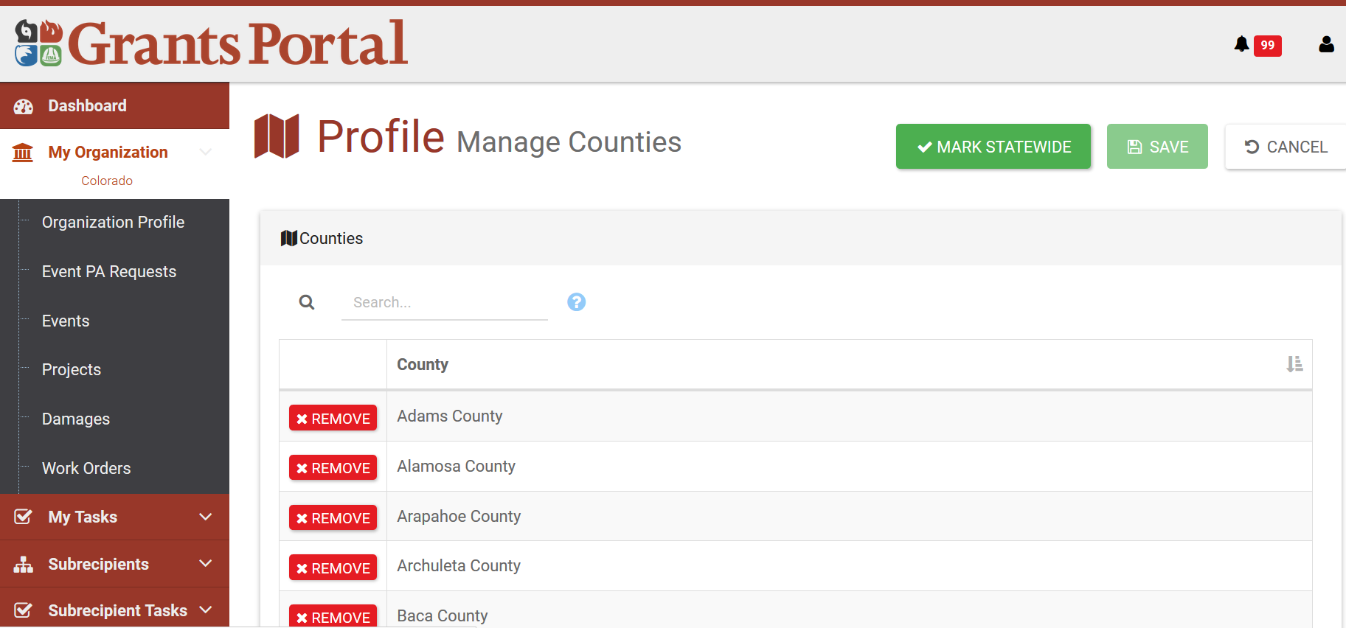
Manage Counties with Facility

Slide 32
Once logged out, Applicant will receive below Email awaiting Recipient’s Approval

Slide 33
Recipient will then receive below Org Account Request Email Notification

Slide 34
Upon obtaining Recipient Approval, Applicant receives Email with Username & Temporary Password
Applicant clicks the link “here” to go right into the system.

Slide 35
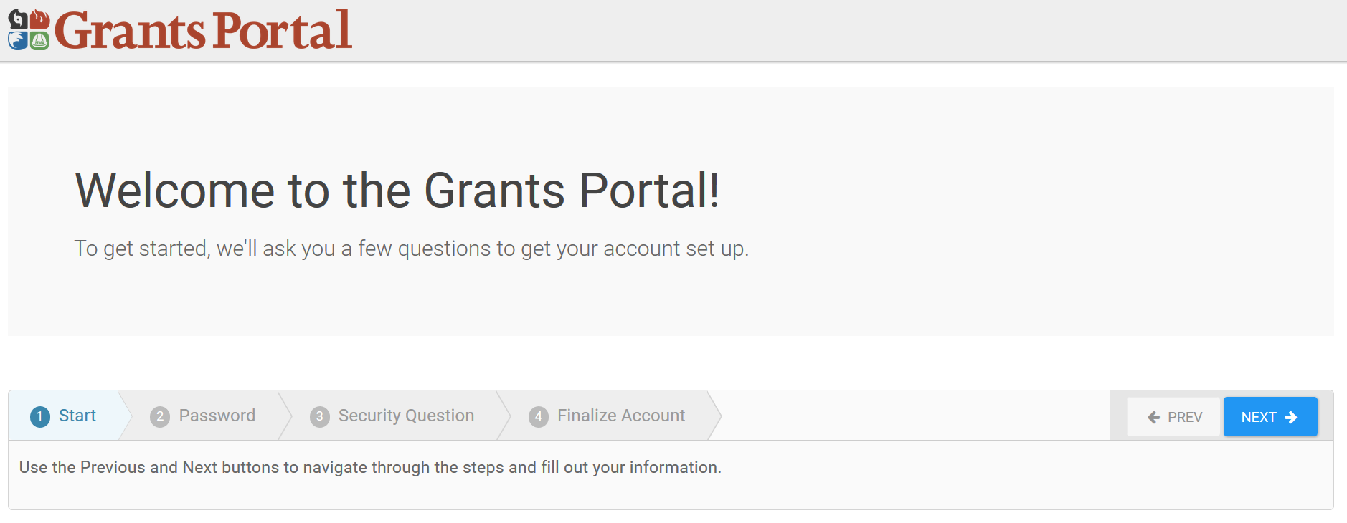
Grants Portal – Account Set up

Slide 36
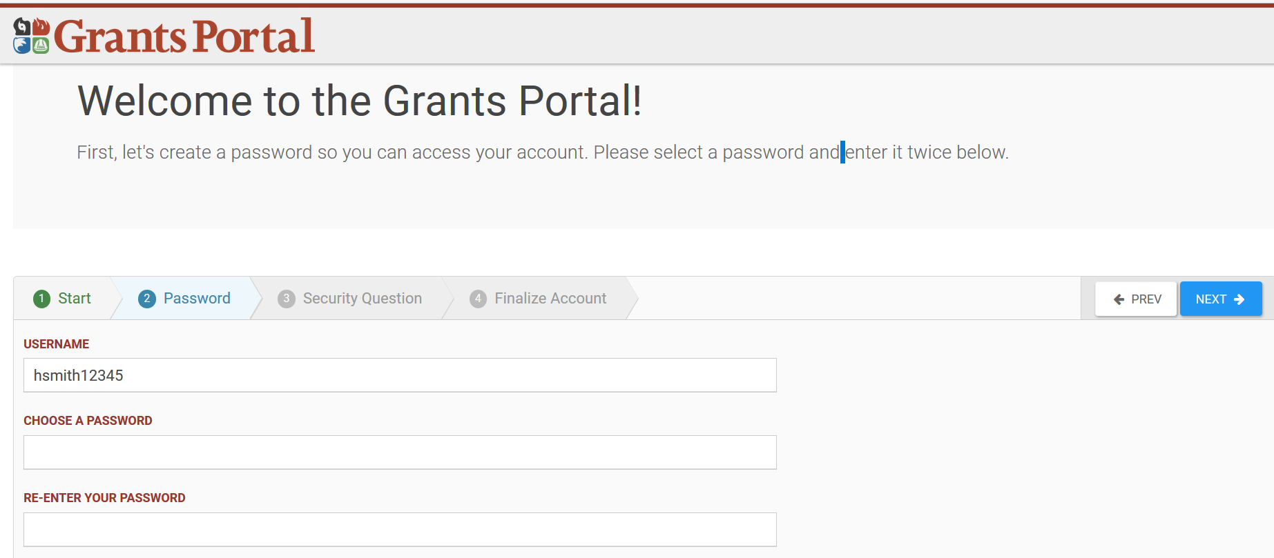
Grants Portal – Account Set up

Slide 37
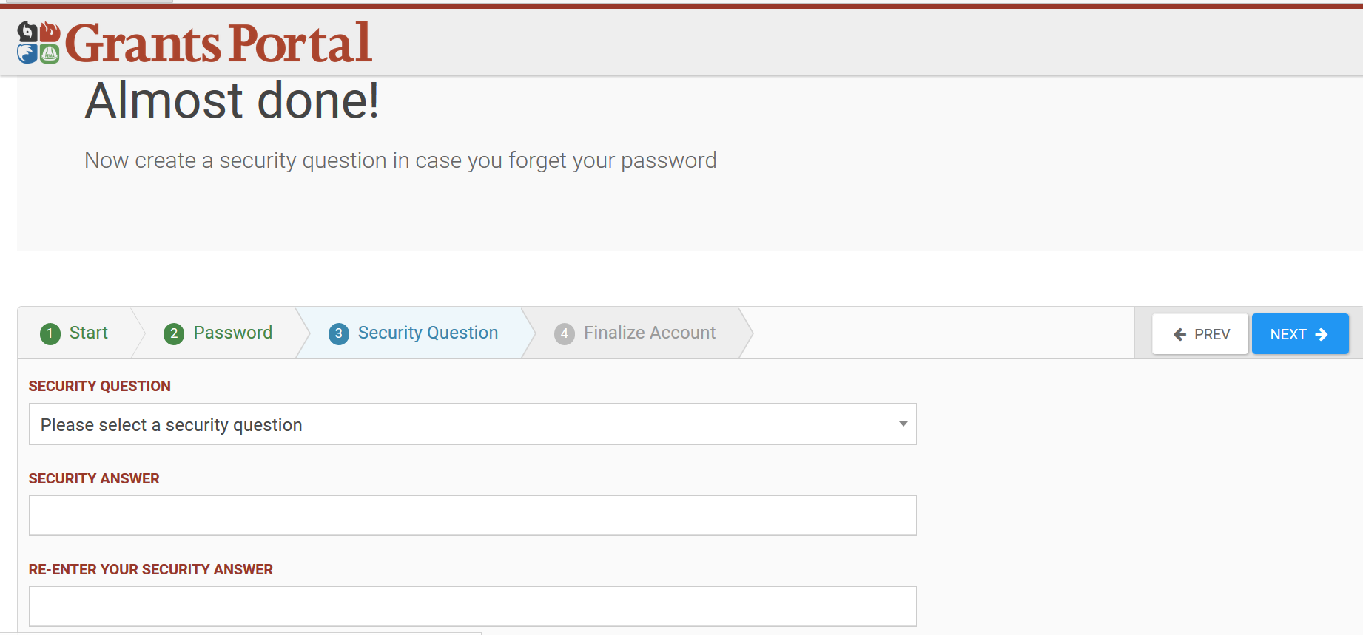
Grants Portal – Account Set up

Slide 38
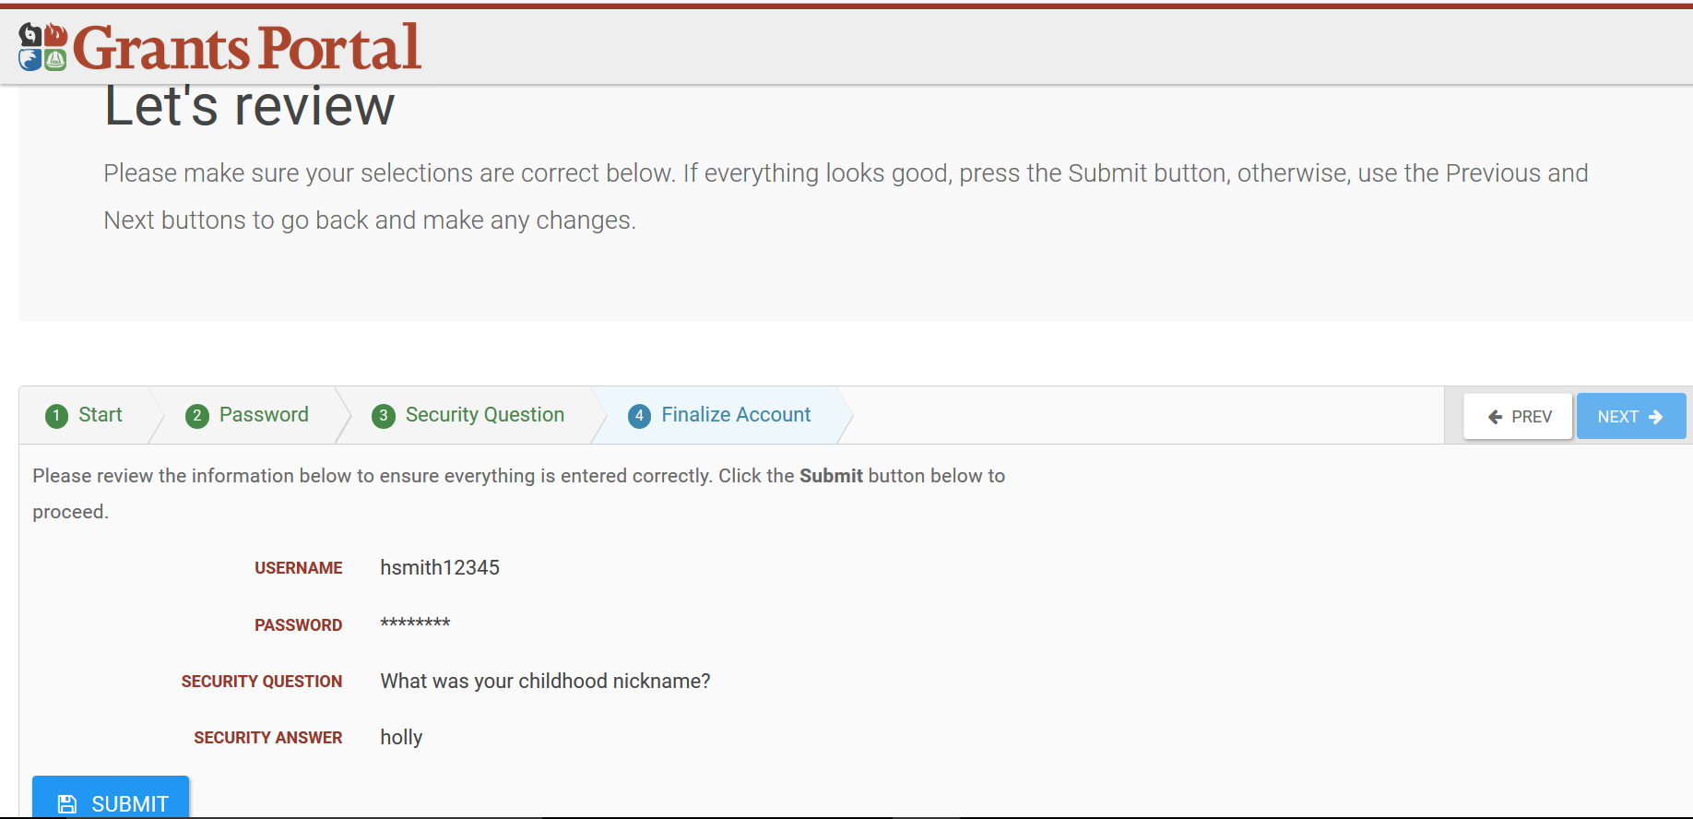
Grants Portal – Account Set up

Slide 39
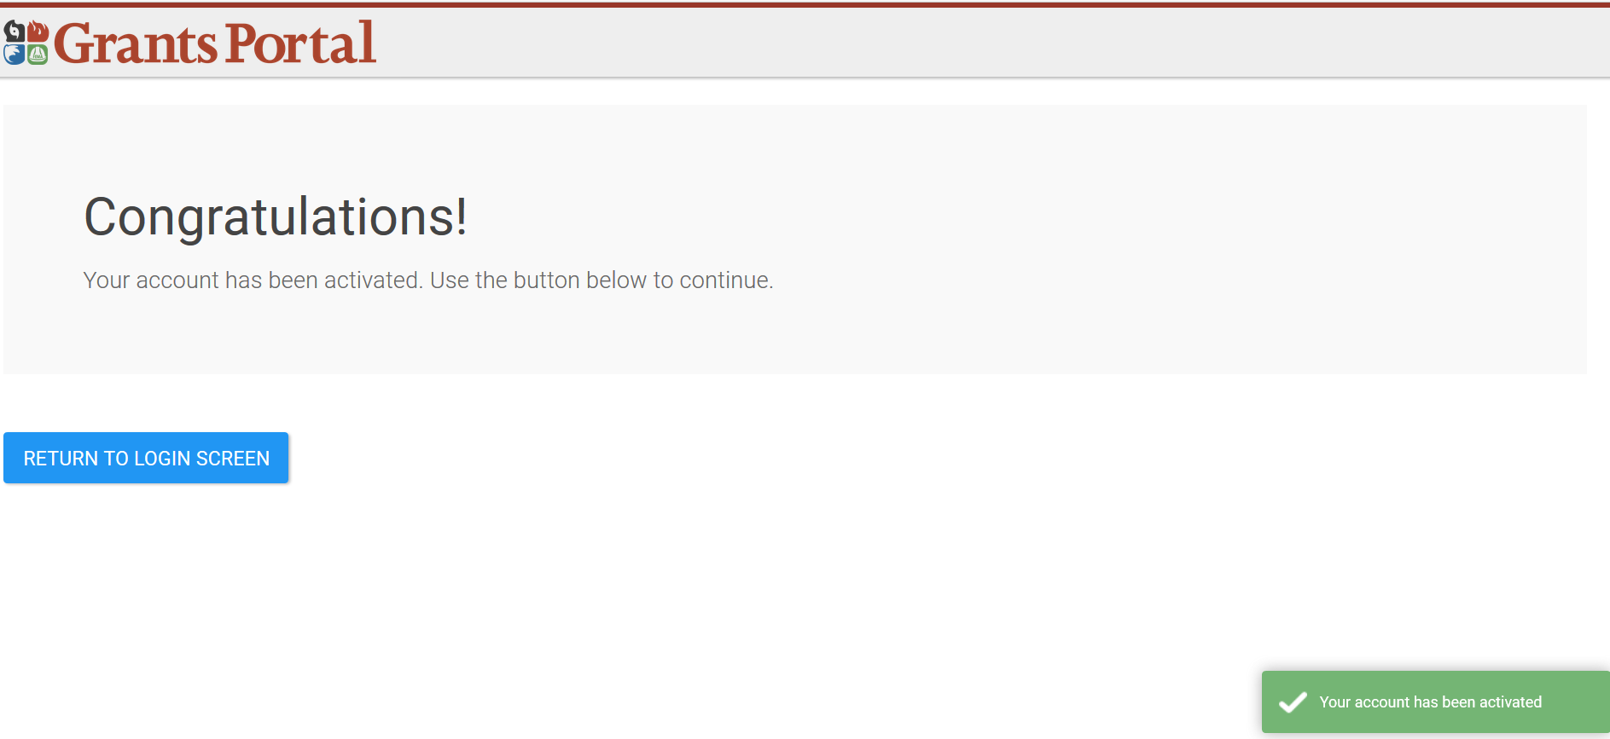
Grants Portal – Account Set up

Slide 40
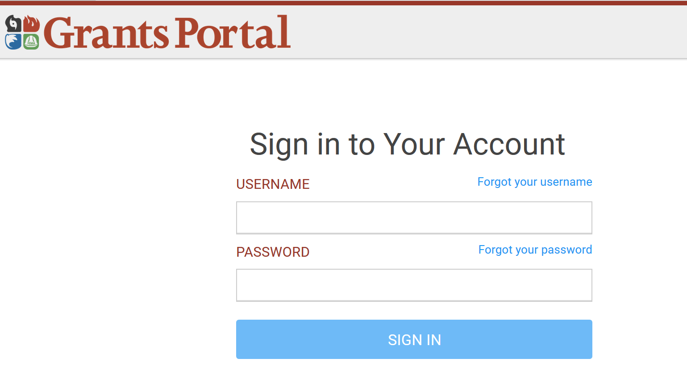
Log Into Live

Slide 41
Customize Dashboard Screen
This button on your browser enables you to zoom in and out adjusting the size of the information.

Slide 42
Signing Out

Slide 43
DDD’s & Projects can now be signed inside the Grants Portal

Slide 44
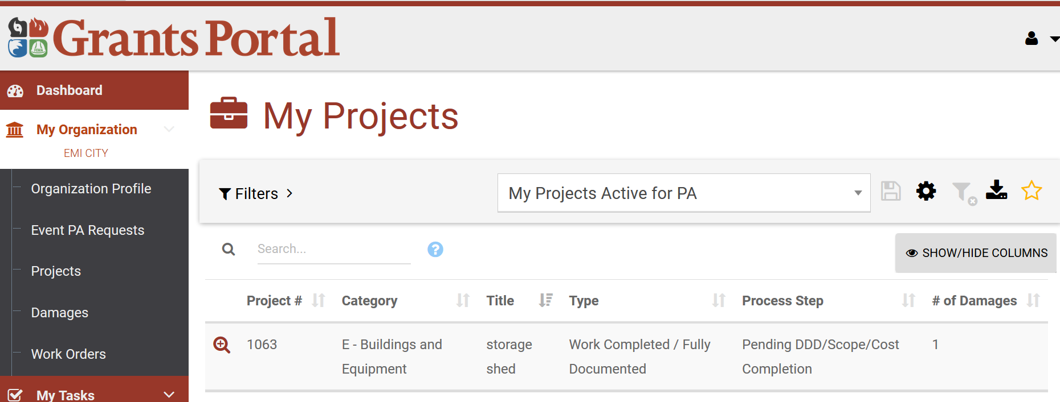
Type Project # in the Search Box

Slide 45
Click “Sign Scope & Cost Project”

Slide 46
Click “Submit” button

Slide 47
“Click to Sign” button

Slide 48
Fill out and click “Sign” button

Slide 49
Click “Submit” button

Slide 50
Click “Yes” button

Slide 51
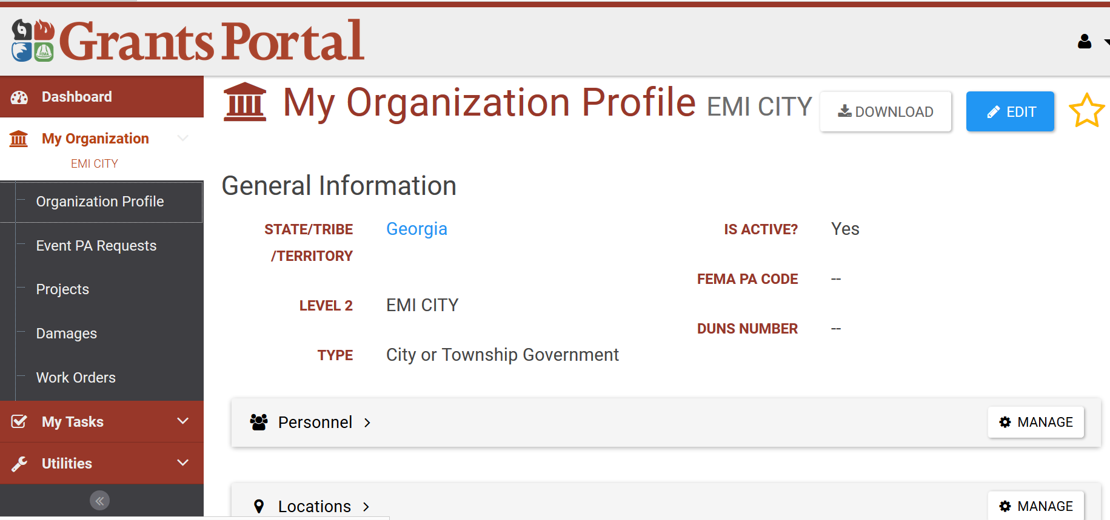
Applicant locked out of Portal? Recipient goes to “Organization Profile” Under “Personnel” tile, click “Manage”

Slide 52
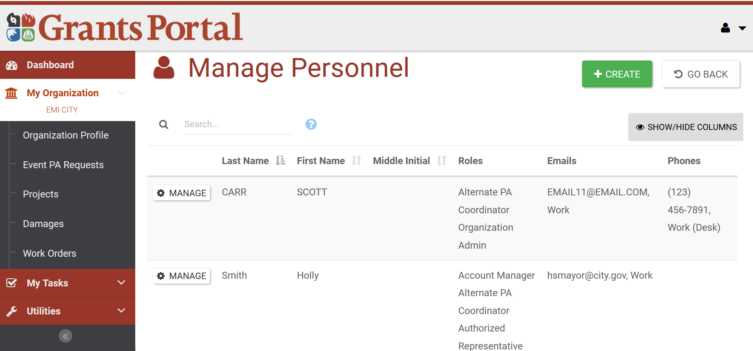
Applicant locked out of Portal? Click “Manage Personnel”

Slide 53
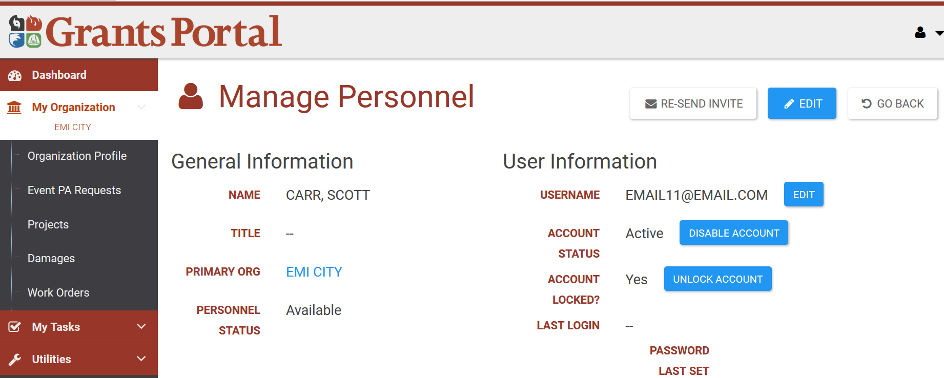
Applicant locked out of Portal? Click “Manage Personnel”

Slide 54
SUPPORT HOTLINE
1-866-337-8448
JOB AIDS – IN STUDENT MANUAL
Grants Portal Organization Administration User Guide
Grants Portal User Guide Create RPA
Grants Portal : Manage Personnel

Slide 55
What’s Coming Next?
As of Sprint 3 - March 17, 2017
Icon for projects awaiting Applicant signature
Capability for Recipient to sign on Applicant’s behalf
Future Releases
Capability to create projects in Grants Portal
Mobile App for site inspections, Applicant concurrence
Notes:
Instructor Notes:
What are the current updates coming and when?

Slide 56
Questions

Slide 57
Conclusion of Unit 7
Course Evaluation and Comment

